Slide 1


BOUNDARY WATERS FISHING
TIPS & TRICKS
By Rob Crist

Slide 2
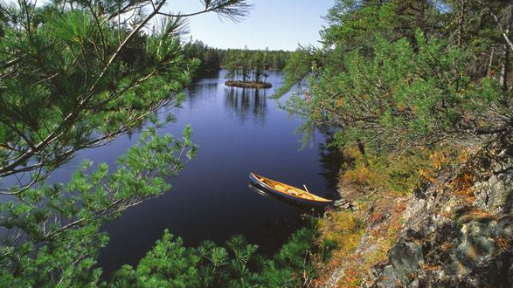
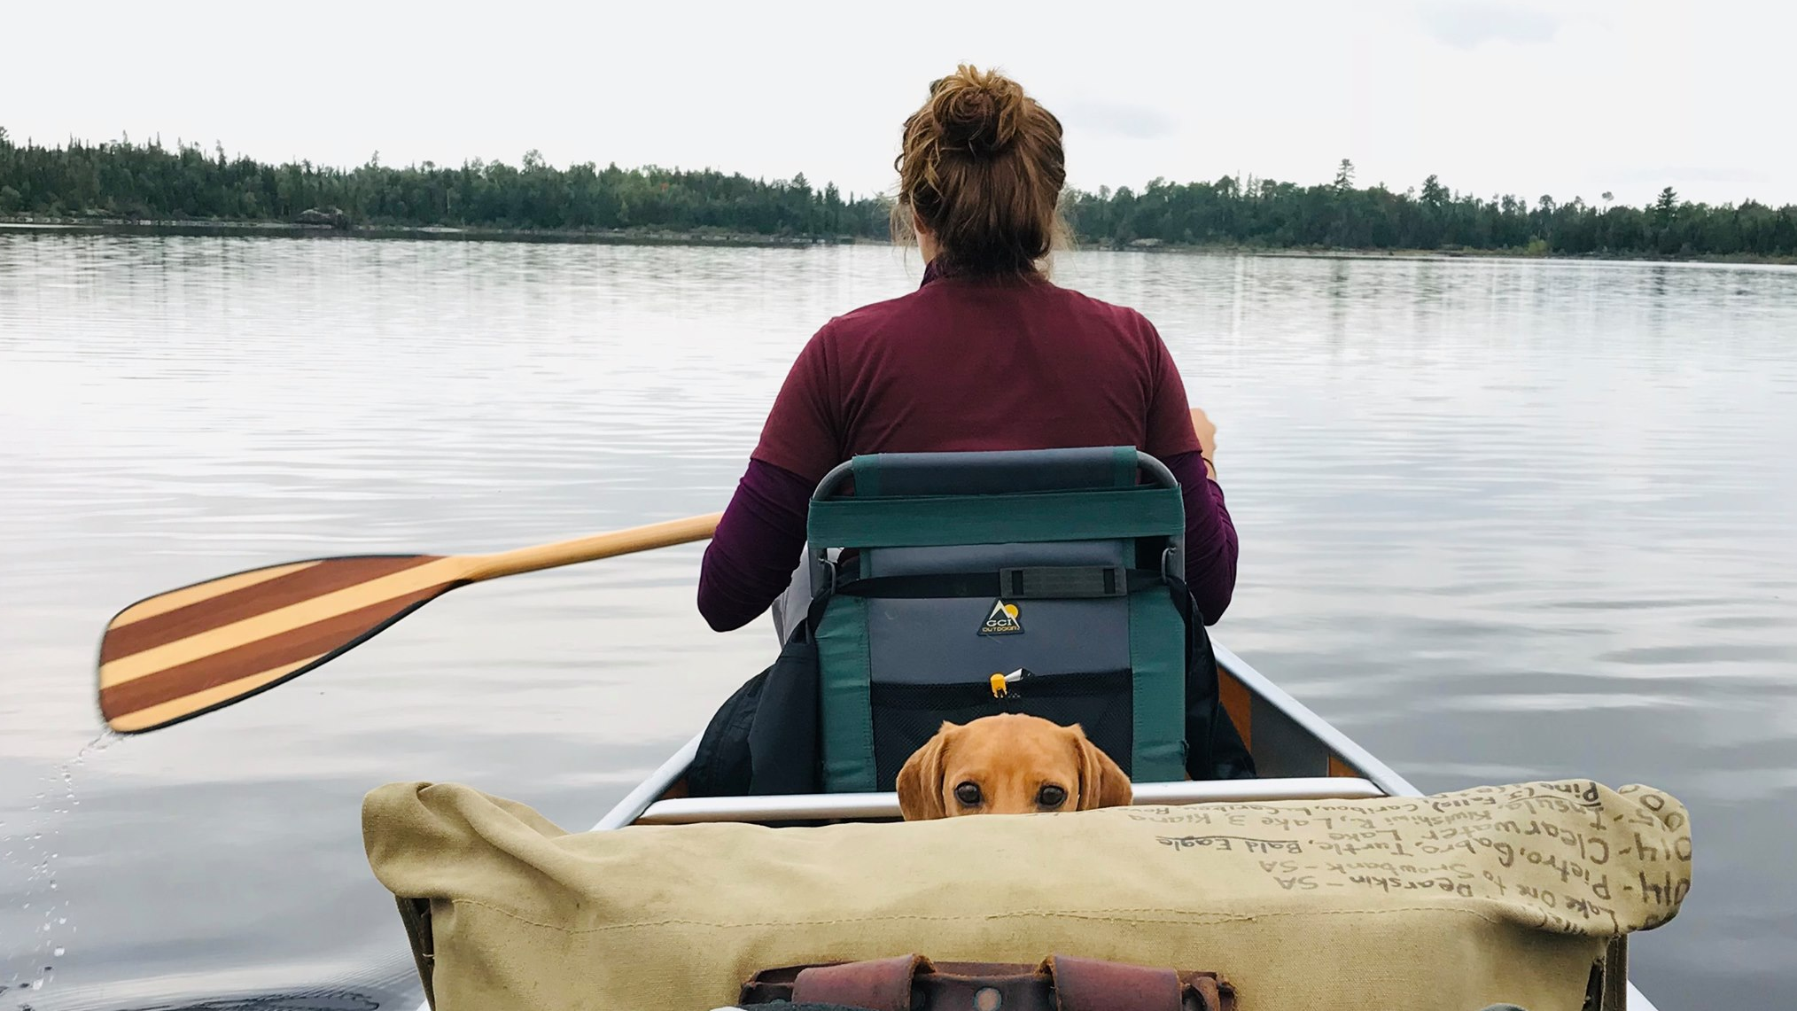
1,000,000+ Acres
1000+ Lakes & Streams
2000+ Campsites
“
If people concentrated on the really important things in life, there'd be a shortage of fishing poles
-DOUG LARSON

Slide 3

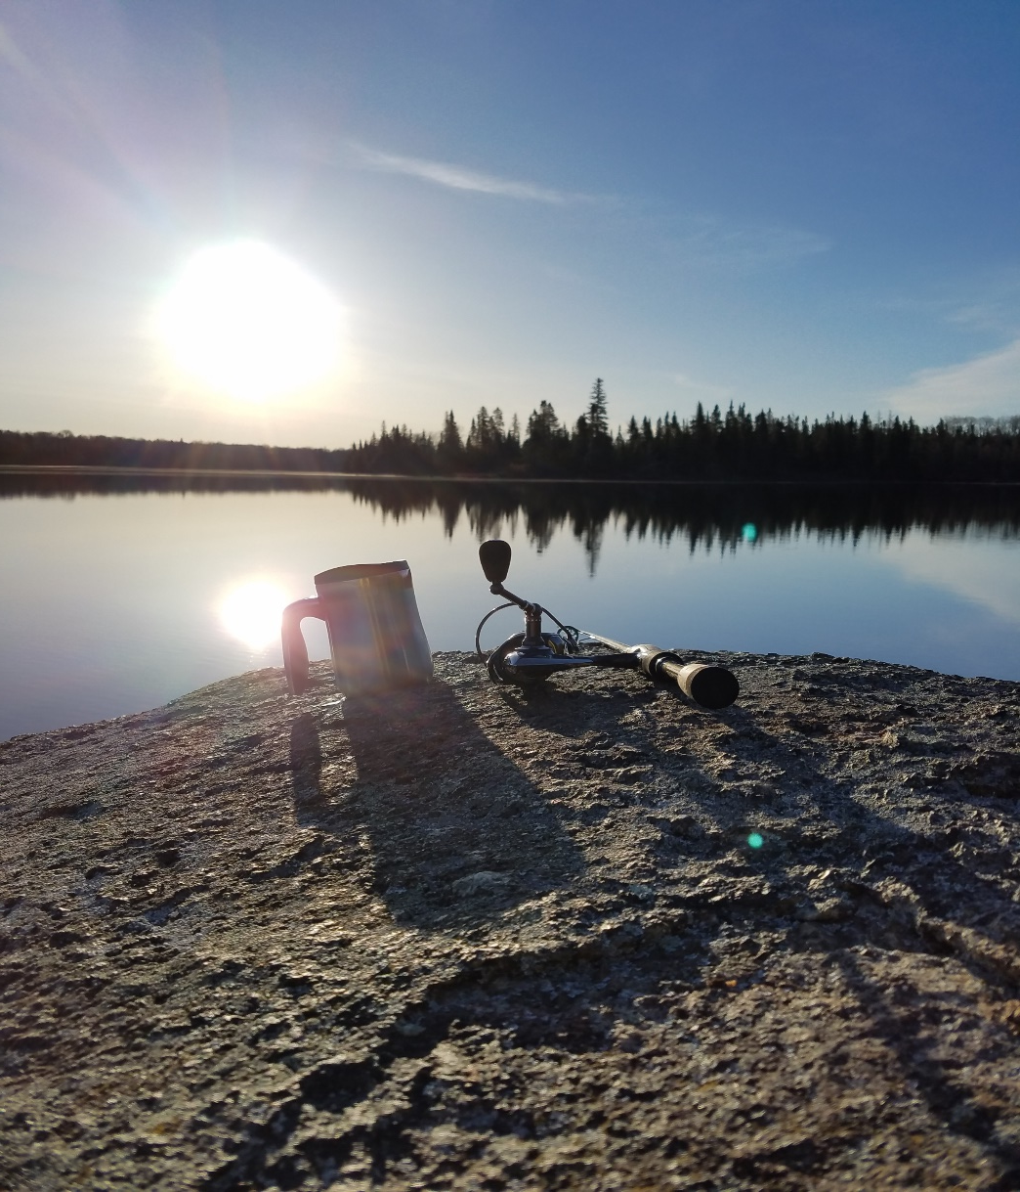
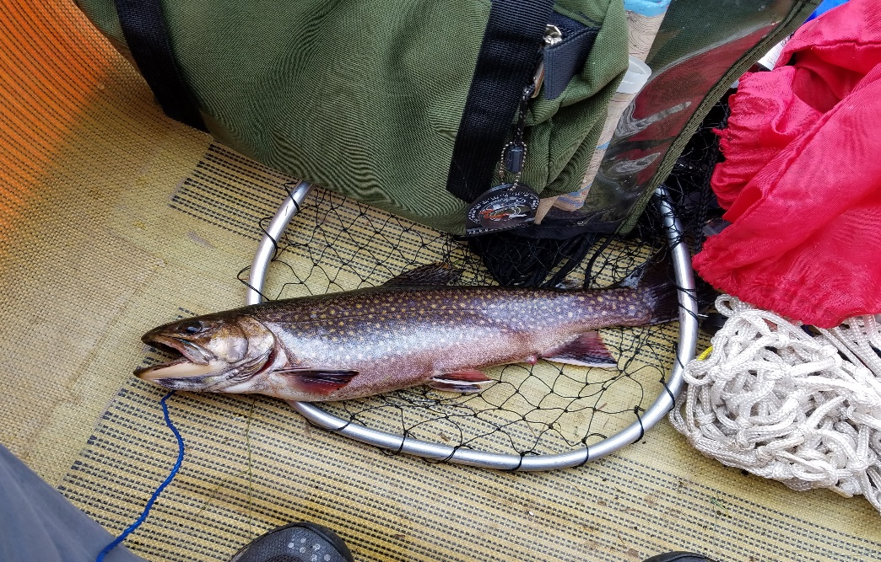
FISHING
LOGISTICS
Fishing License
Fishing Regulations
Equipment
BWCA Considerations
  Portaging
  Weight
  Human Power
https://www.dnr.state.mn.us/regulations/fishing/index.html

Slide 4
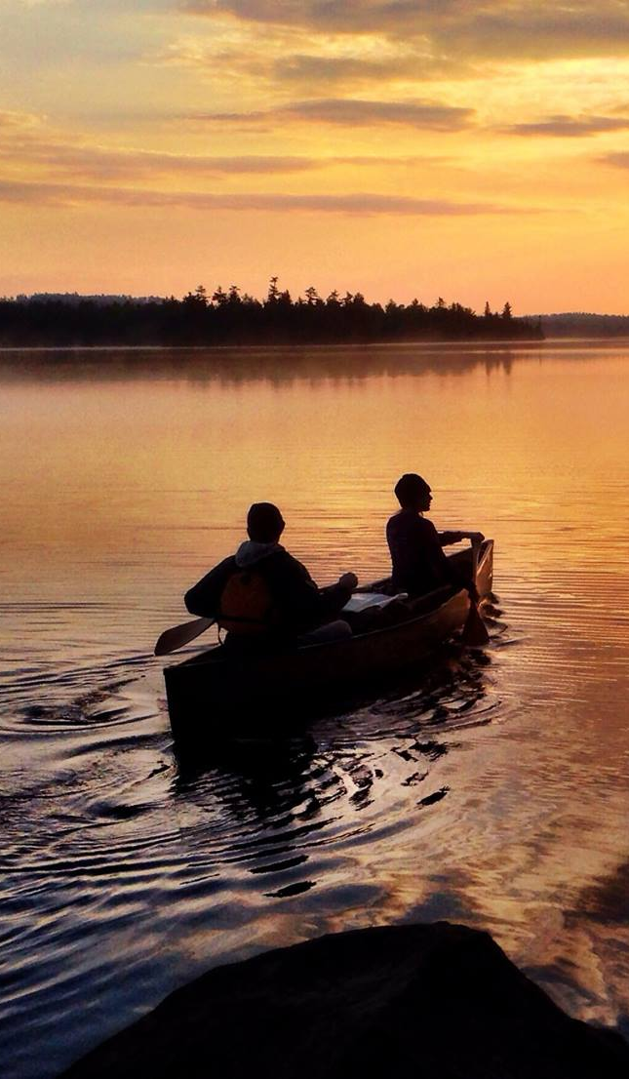
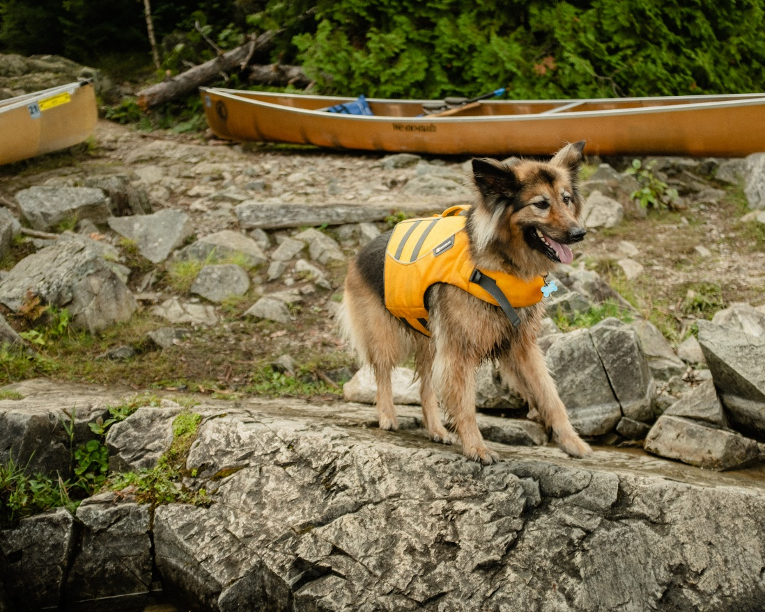
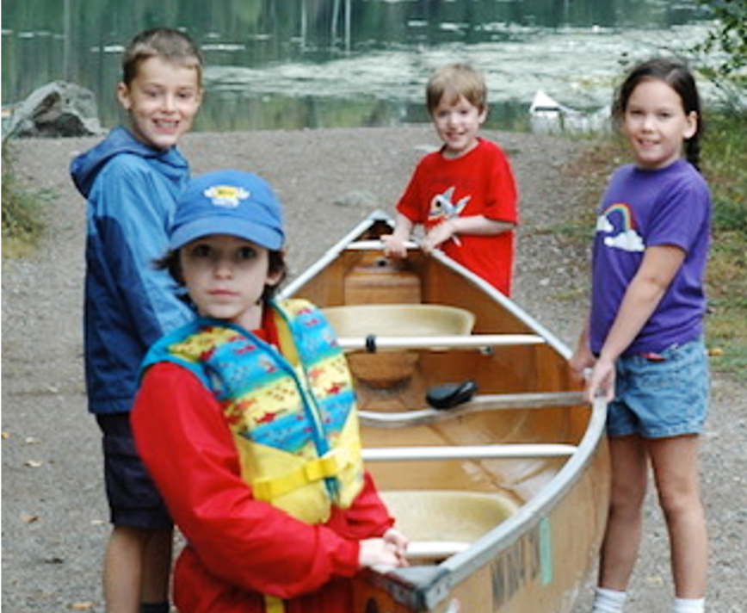
FISHING
VARIABLES
Species
  Lake Finder
Technique
Lake Structure
  Google Earth/Maps
  Navionics
  MN DNR
Weather
Time of Year

Slide 5
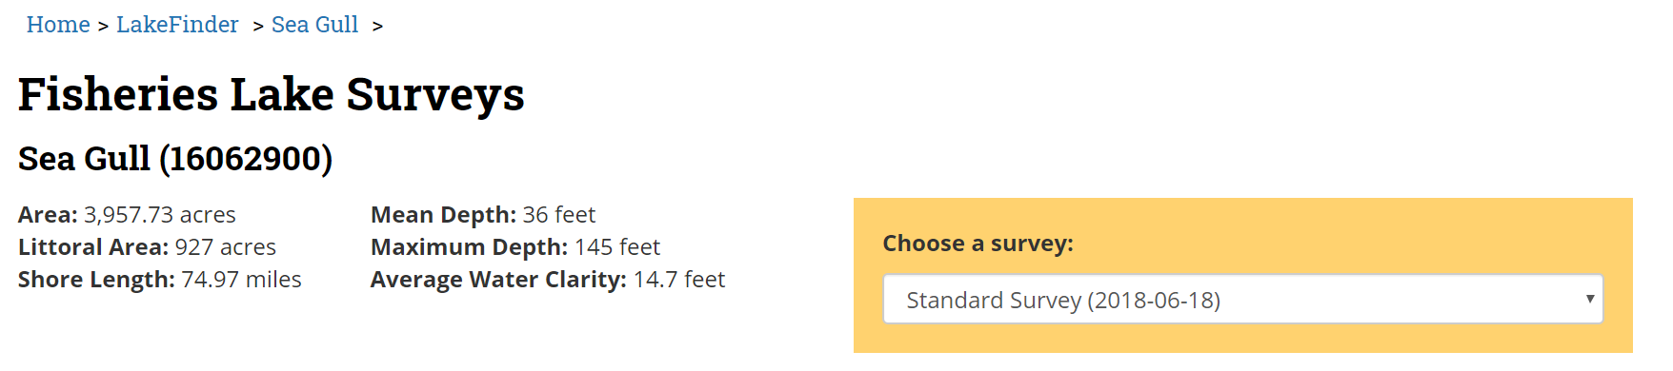
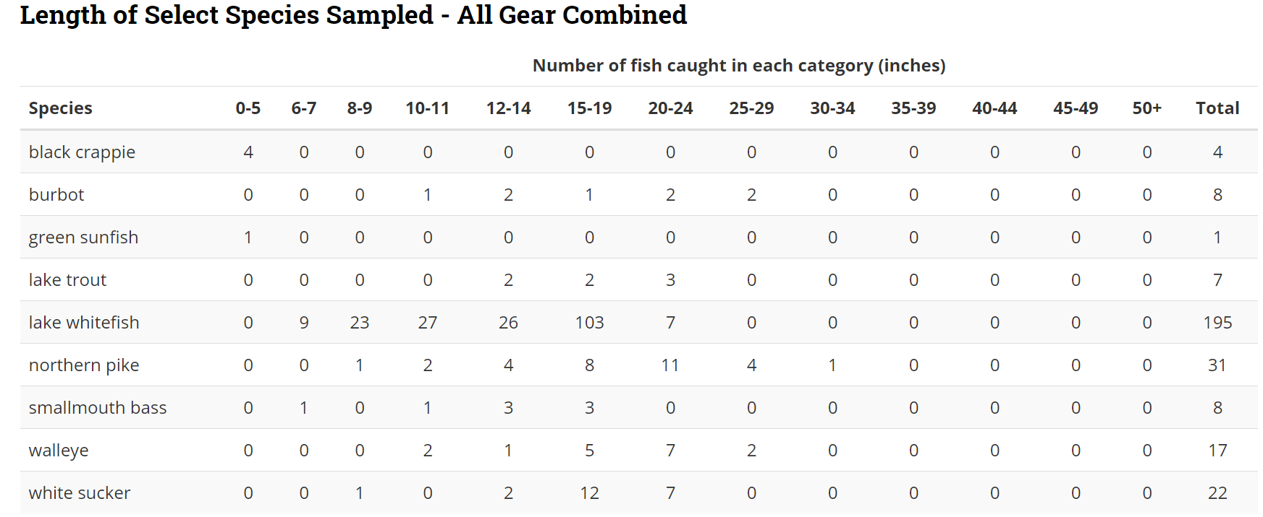
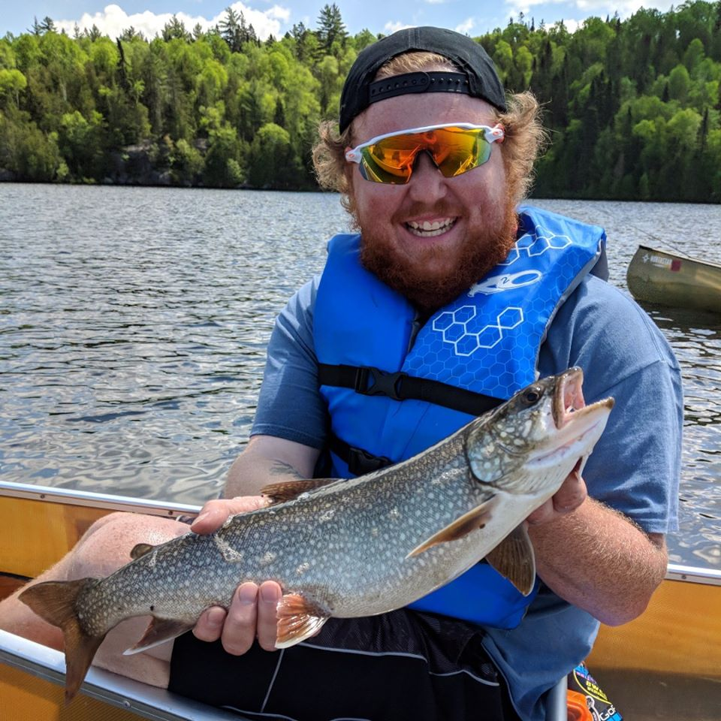
LAKE FINDER
Identify species to target
Sample numbers and sizes
Most BWCA lakes included
Thorough Lake Summaries
https://www.dnr.state.mn.us/lakefind/index.html

Slide 6
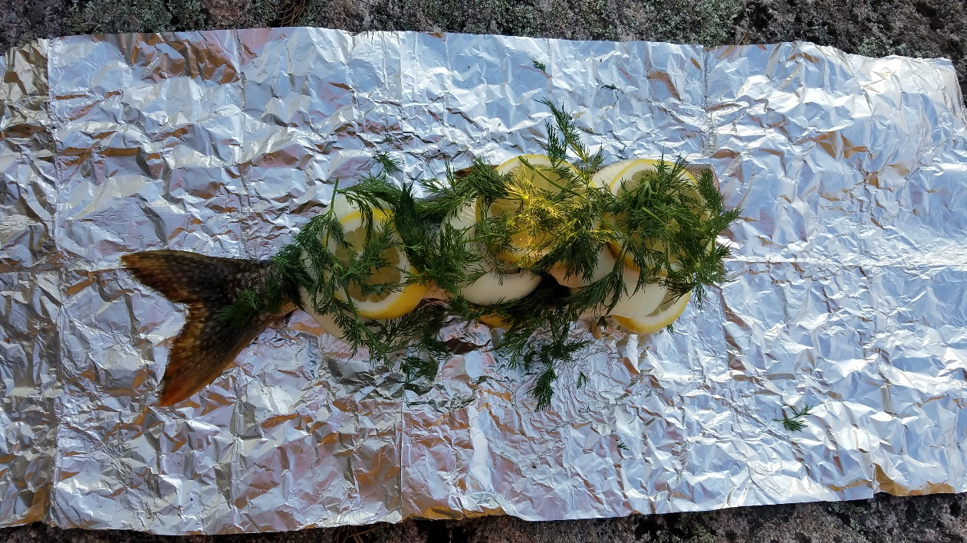
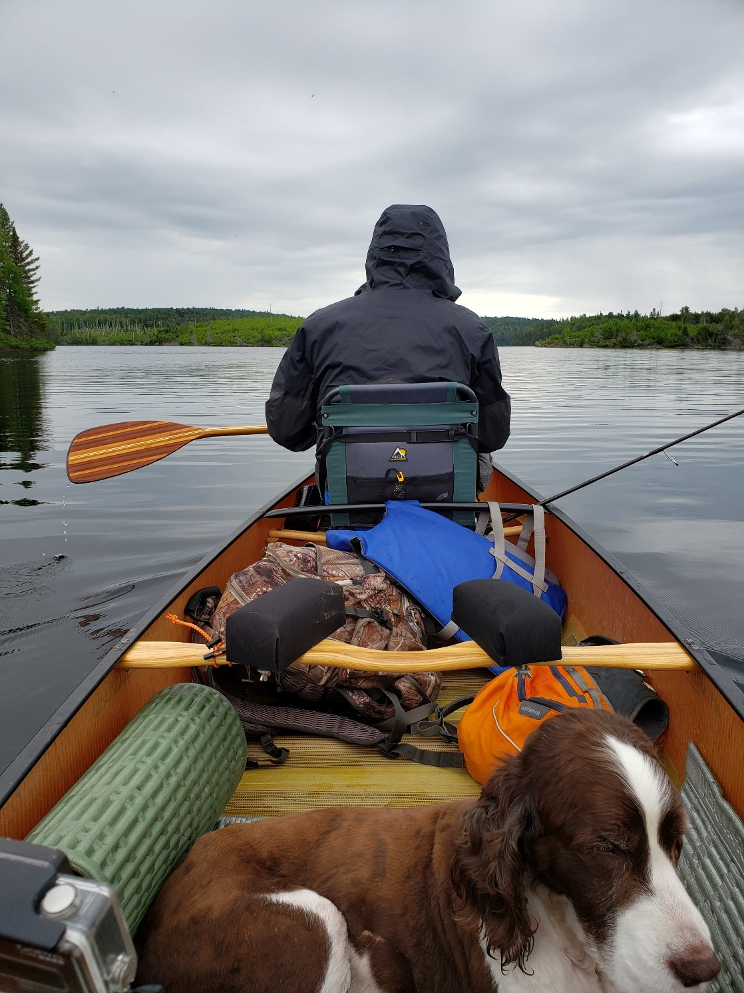
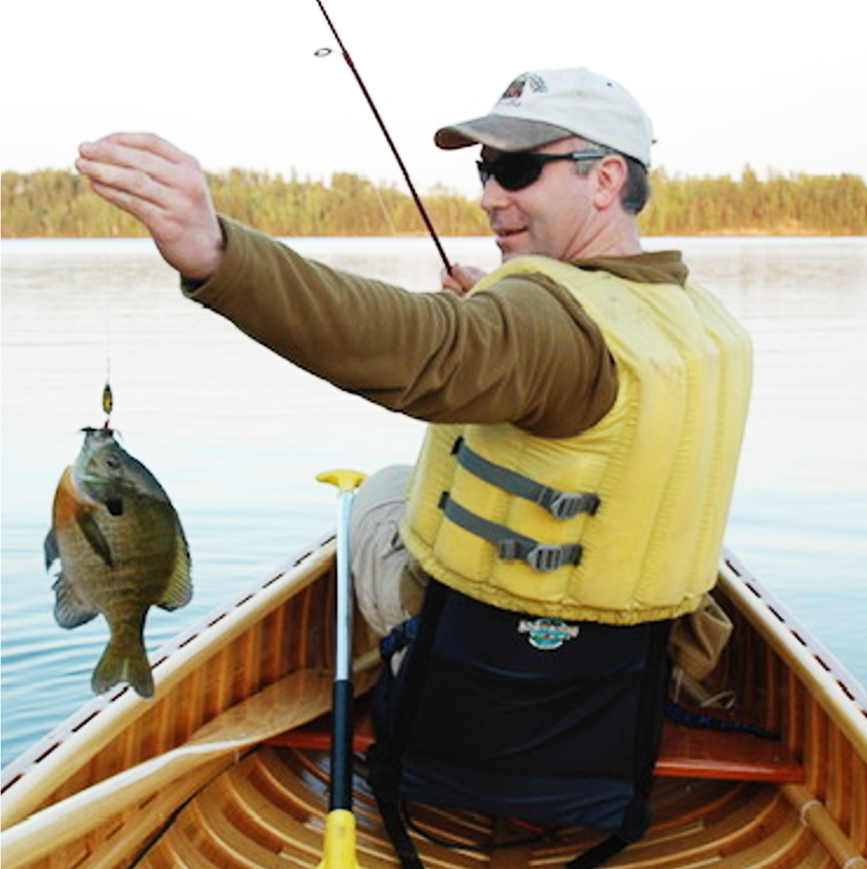
TECHNIQUES
Jigging
Trolling
Slip-Bobber
Spinner
Top Water
Cranks

Slide 7
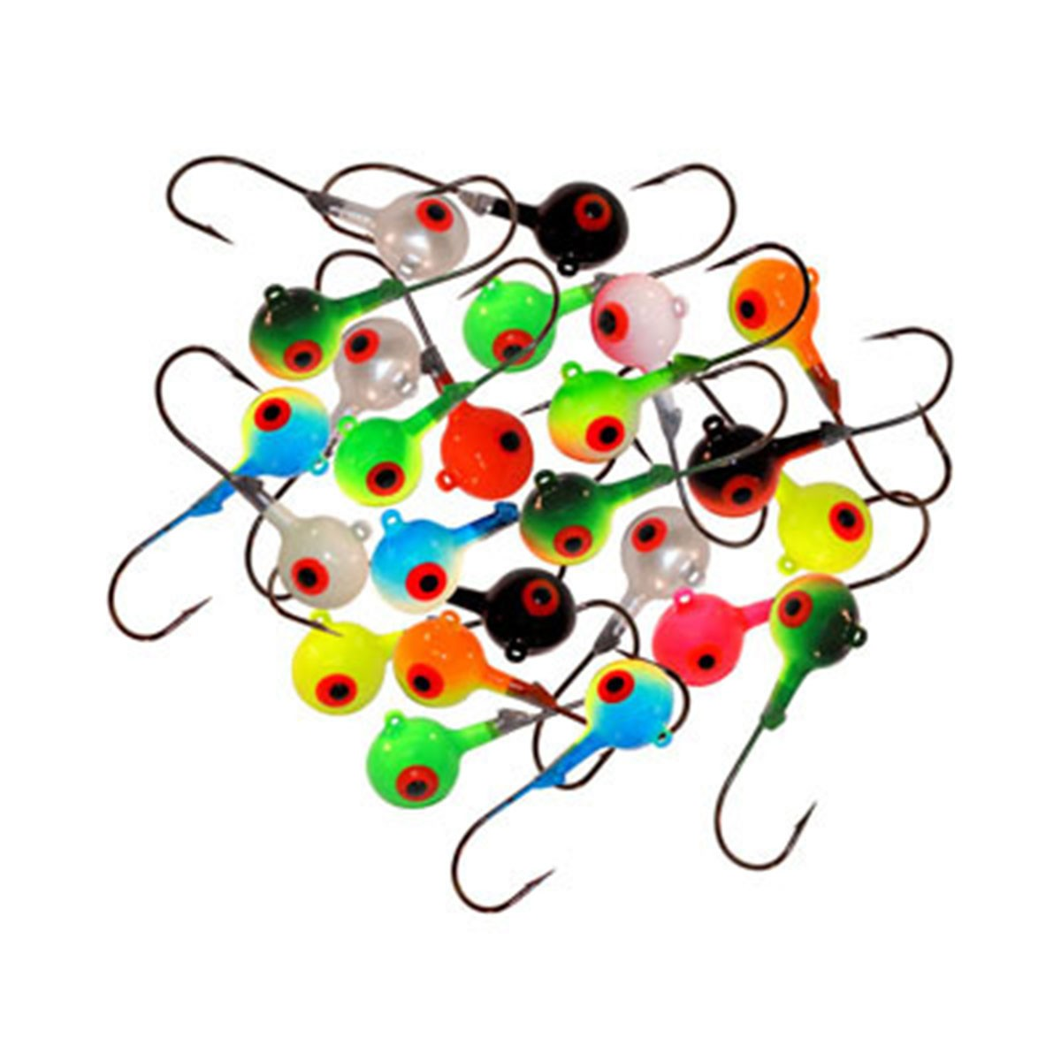
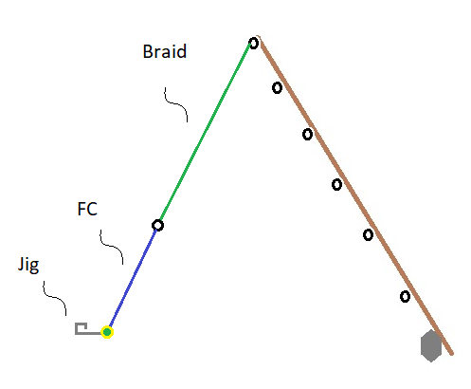
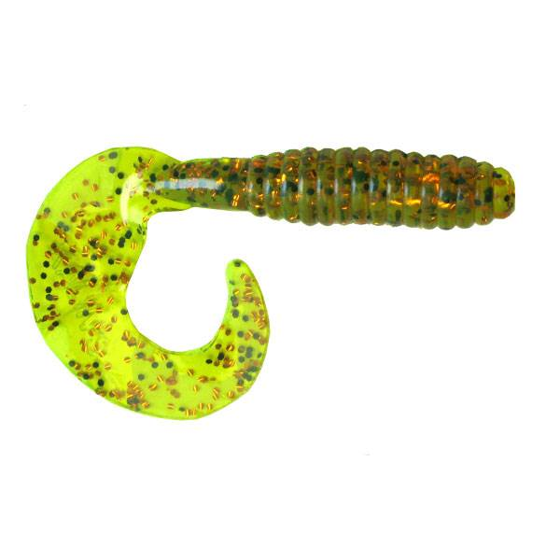
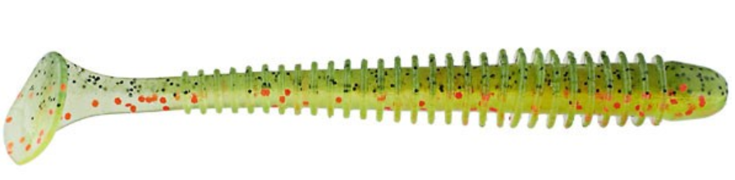
Jigging
Northland Jig
Jigging RIg
Simple, multi-species approach
Artificial Lures or Live Bait
Weedless capabilities
Multiple ‘actions’
Sensitivity is key
Can get stuck easily
Kalin’s Lunker Grub
Keitech Swing Impact

Slide 8
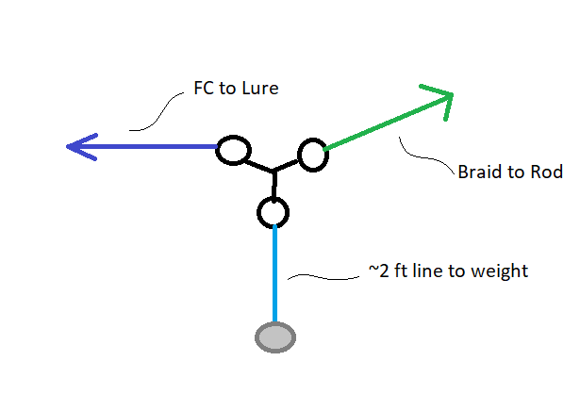
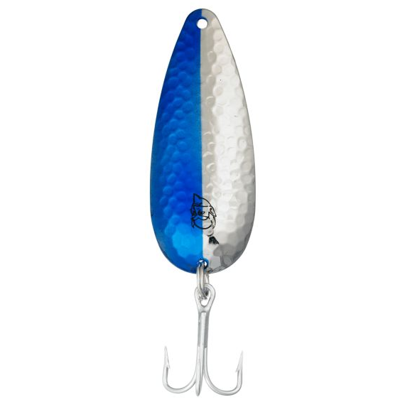
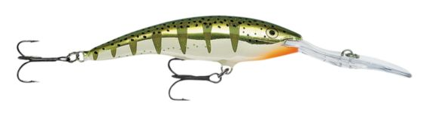
Trolling
3-Way Swivel Rig
Grab bag for species
Artificial Lures or Live Bait
Adjustable depth
Best for Lake Trout
Daredevle Spoon
Rapala Tail Dancer

Slide 9
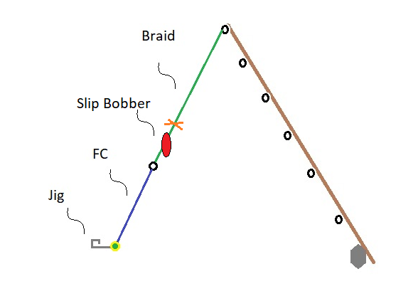
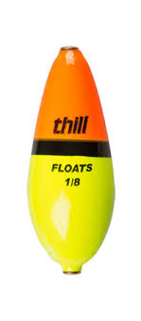
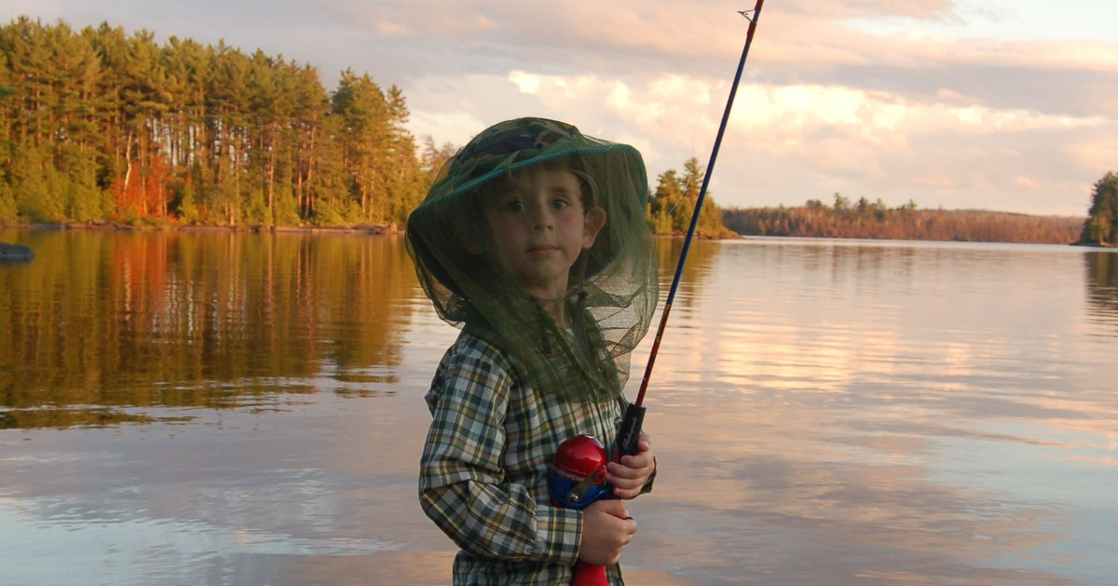
Slip Bobber Rig
Slip Bobber Rig
Live Bait Presentation
Visual Fishing, less feel
Great for ‘slow bites’
Great for younger anglers
Focus on specific depth
Thill Wobble Bobber

Slide 10
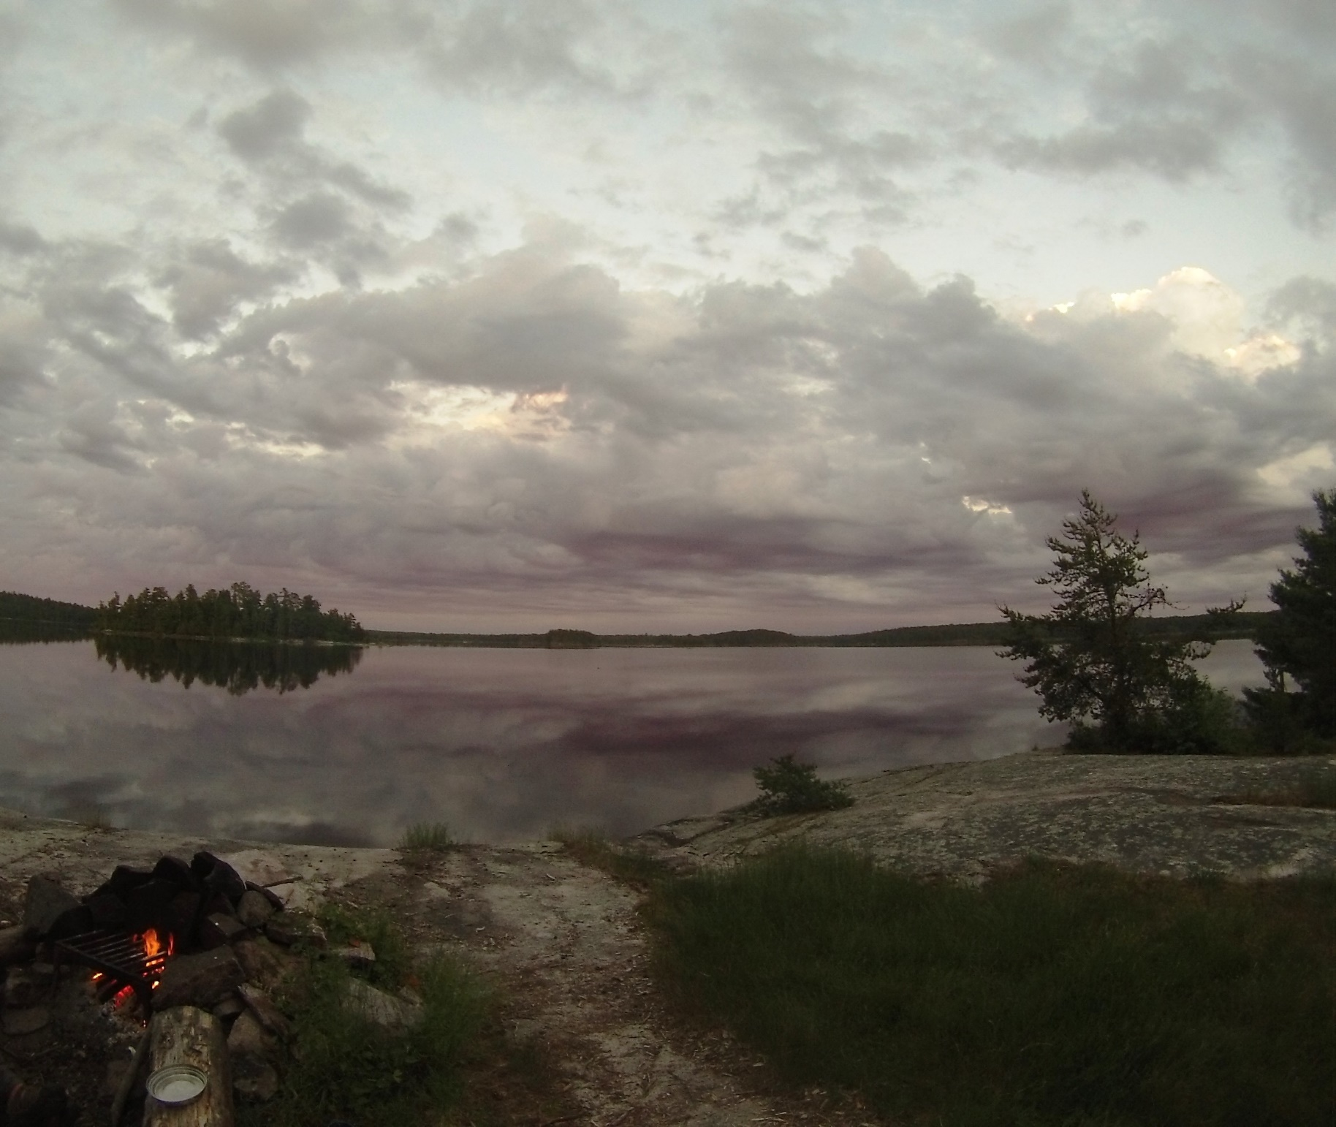
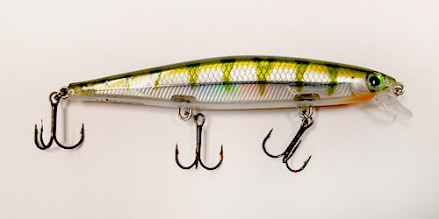
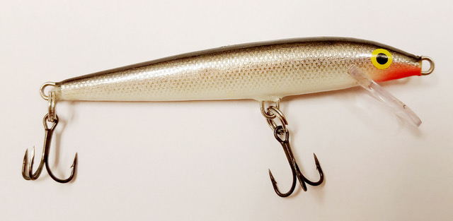
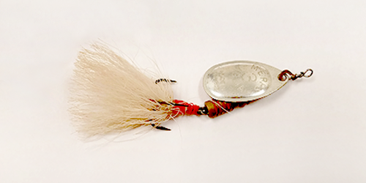
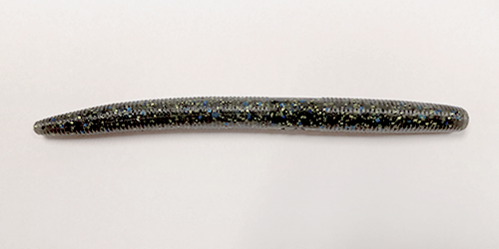
Lures, colors, and weather
Rapala Shadow Rap
Floating Rapala
Mepps Dressed Agila
Yamamoto Senko

